Slide 1


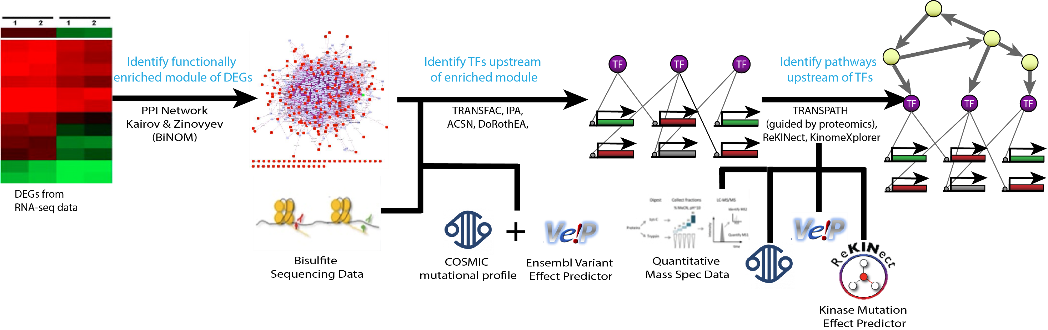
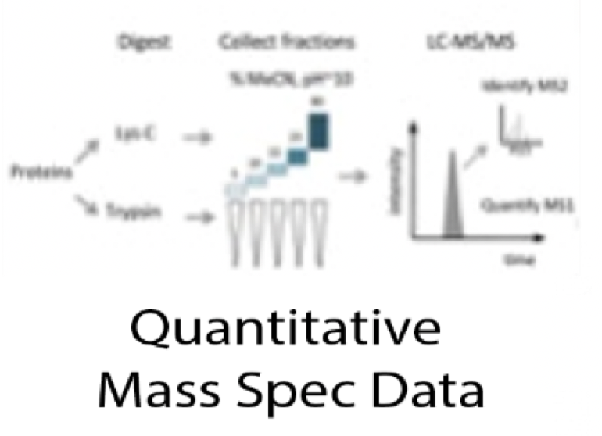
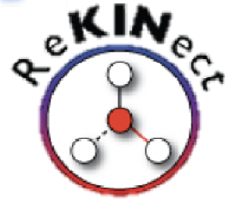



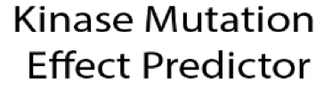
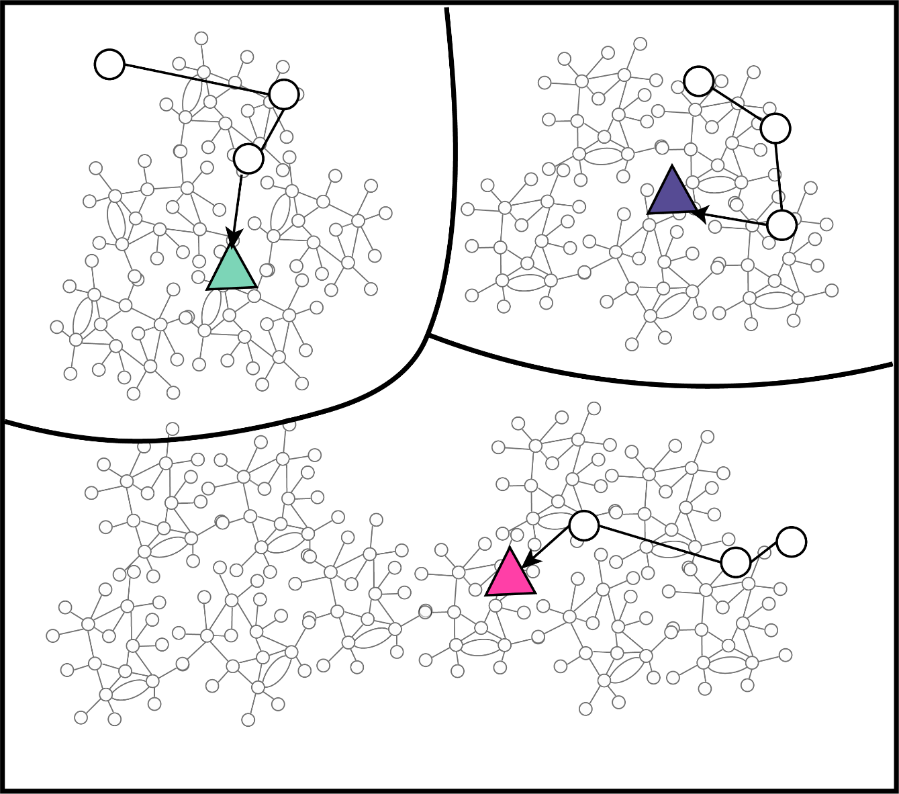
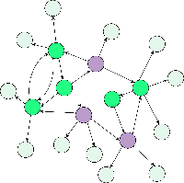
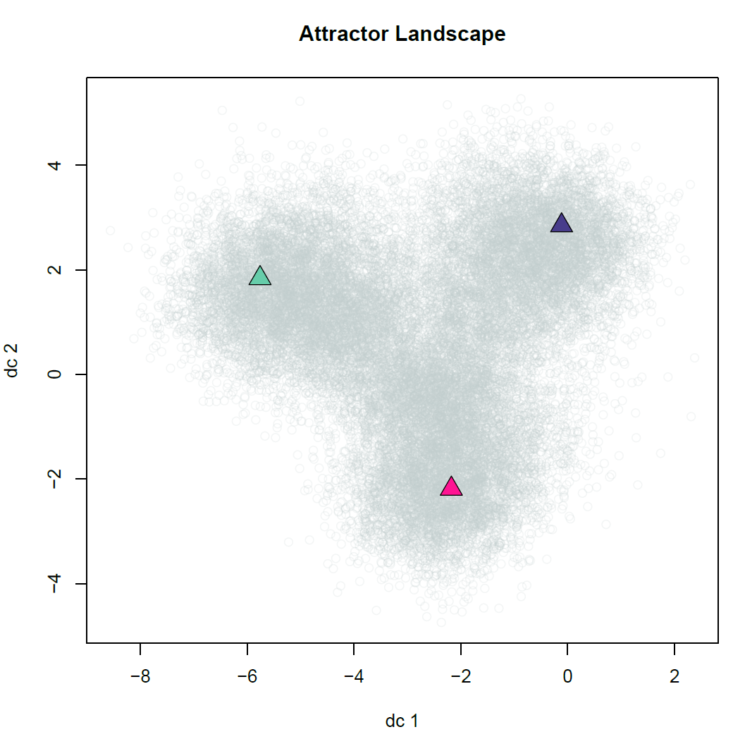
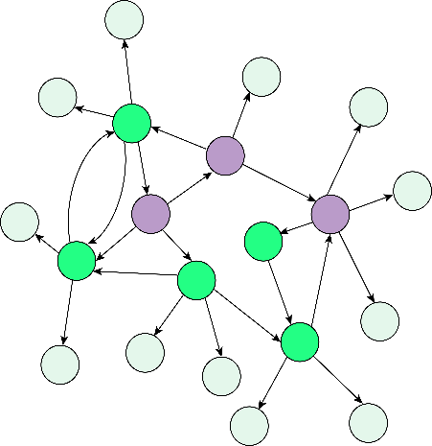

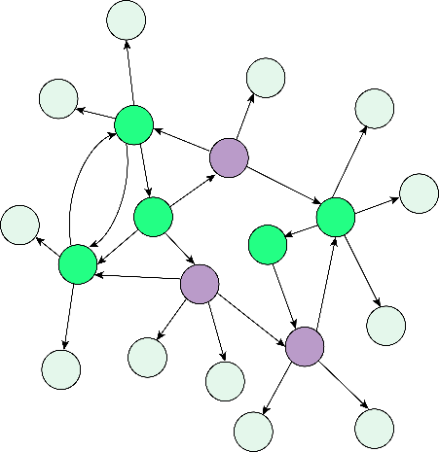
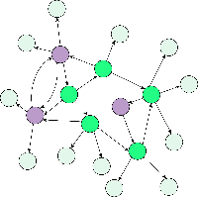
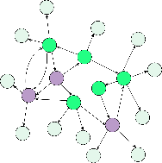
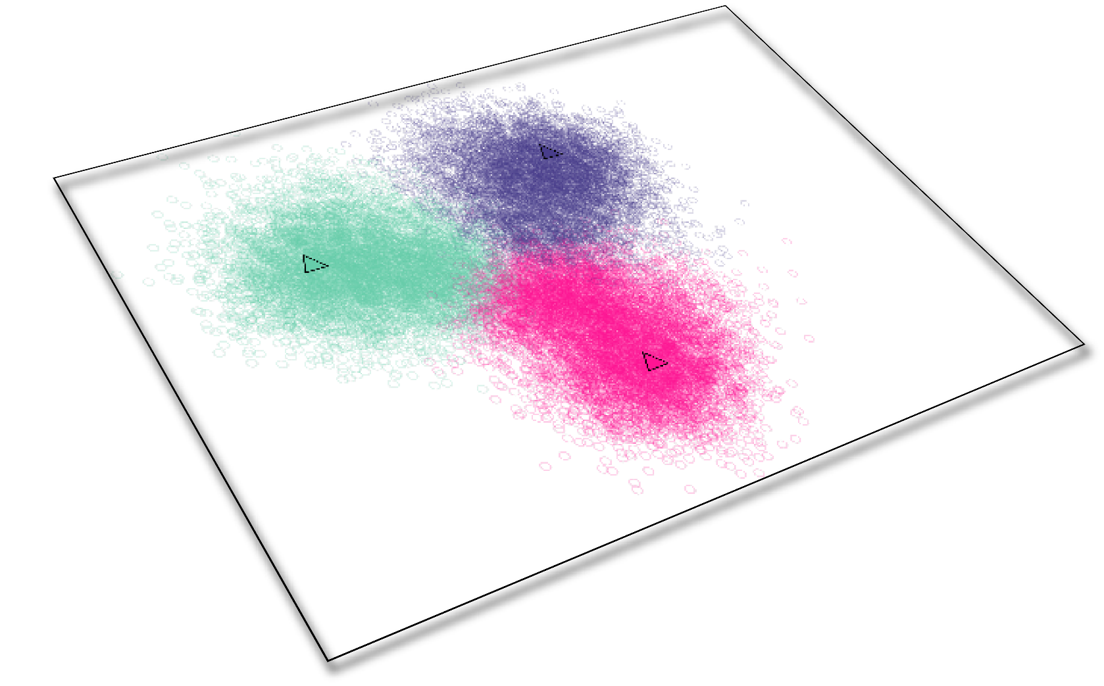
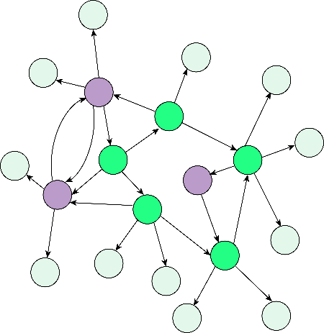

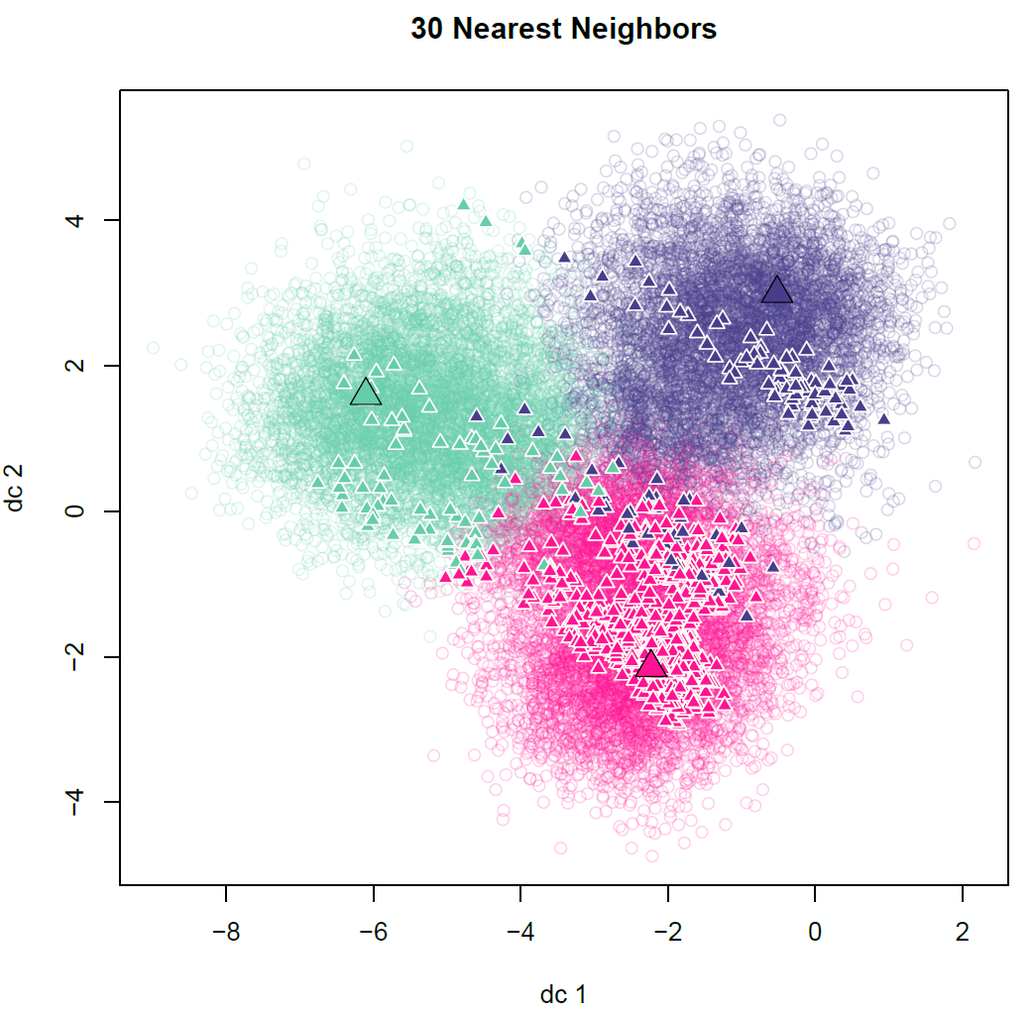
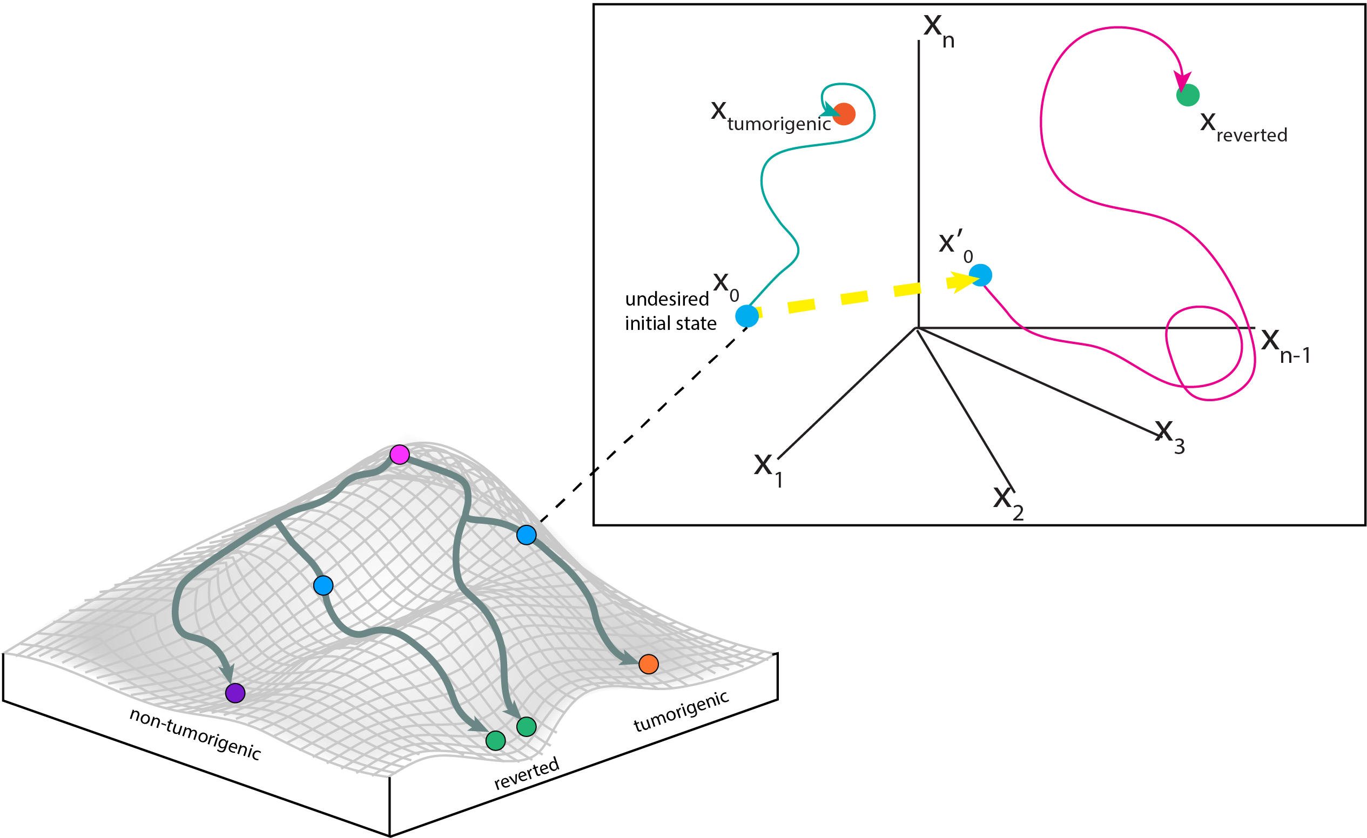
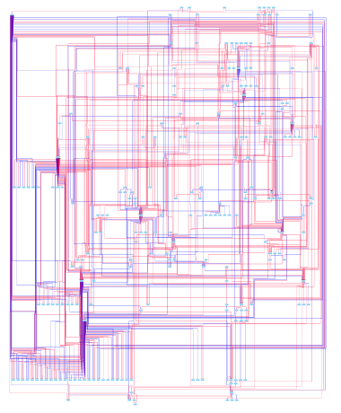
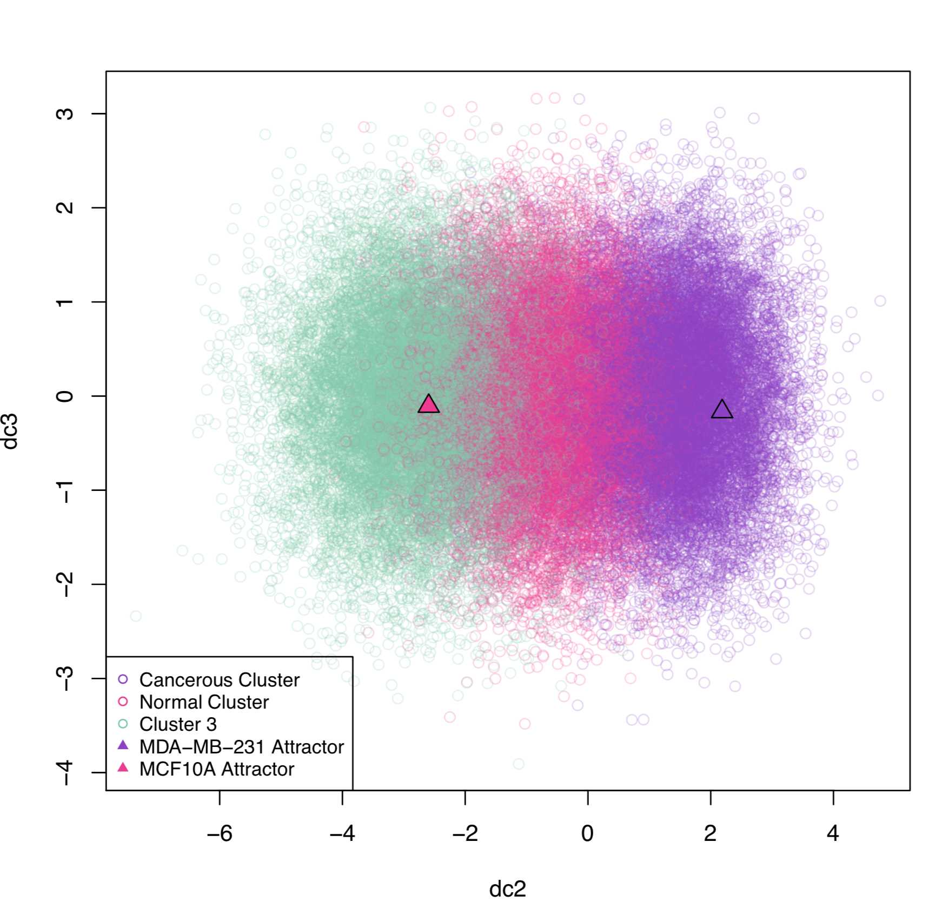
Identification of Combinations of Targets for Claudin-Low Triple Negative Breast Cancer Reversion
Madeleine S. Gastonguay¹, Lauren Marazzi¹, Paola Vera-Licona¹
Center for Quantitative Medicine, UConn Health, Farmington CT 06030
INTRODUCTION
METHODS
Claudin-Low Triple Negative Breast Cancer (CL TNBC) is an aggressive subtype of TNBC with a poor prognosis¹⁻⁴ (Fig 1). Current breast cancer therapies are not effective in treating this cancer, creating the need for a new therapeutic approach⁵.
STEP 1. Reconstruction of Tumorigenic Network Using Multi-Omics Data (Fig 3). RNA-seq data¹⁶, methylation profiles¹⁷, mutational profiles¹⁸, and protein abundance¹⁹ for the CL TNBC cell line MDA-MB-231 and the normal breast cell line MCF10A were used to construct a tumorigenic intracellular signaling network²⁰⁻²⁶.
Triple Negative Breast Cancer (TNBC)
An Aggressive Subtype of Breast Cancer
Claudin-Low (CL) TNBC
A Subtype of Triple Negative Breast Cancer
20%
of Breast Cancers are TNBC¹
7-14%
of invasive Breast Cancers are CL TNBC²
Lacks:
These phenotypic characteristics:
ER
Estrogen
Receptor
HER2
HER2 protein
PR Progesterone Receptor
EMT
Undergoes Epithelial
to Mesenchymal Transition
Proliferation
Low proliferation rates
Stemness Exhibits stem-cell
like characteristics
Therefore targeted breast cancer therapies are not effective¹
Lead to high rates of metastasis²⁻⁴ and poor response to cytotoxic drugs²
Figure 3. Pipeline for the Data-Driven Reconstruction of the Tumorigenic Signaling Network
Figure 1. Triple Negative Breast Cancer Characteristics
Tumor reversion is the biological process by which tumor cells lose a significant fraction of their malignant phenotype⁶. Tumor reversion has been observed in vitro, in vivo, and ex vivo for over a century. In particular, tumor reversion has been achieved with the CL cell line MDA-MB-231 and MDA-MB-231 xenograft mice models⁷⁻¹².
At the cellular level, the development of cancer can be seen as a systems-level dynamical process driven by a tumorigenic intracellular signaling network. Attractors of this network correspond to cell phenotypes¹³. Cancer attractors are attractors presenting a malignant phenotype that are pre-existing in the network but not typically accessible¹³. They can be accessed through genetic mutations or changes in the tumor microenvironment. Tumor reversion can be viewed as an optimal control problem in dynamical systems where the objective is to shift the system away from a cancerous attractor and towards normal-like attractors.
STEP 2. Estimating Attractor Landscape with Topological Signal Flow Analysis²⁷ (SFA). (Fig 4)
STEP 3. Estimating Phenotype Landscape with Unsupervised Machine Learning. (Fig 5)
STEP 4. Applying FC Control¹⁵ and In-Silico Screenings. (Fig 6)
Classified Attractors
(by K-Means)
T0_{Normal}
Simulating network to
identify associated attractor
from each initial condition
T0_{Cancer}
…
Norm₀
…
T0
Norm₀
Network nodes in arbitrary basal state
Other₀
Network nodes in basal state as normal
Ca₀
Simulating network to
identify associated attractor
from initial condition
with FC nodes perturbed
Classify Newly Generated Attractor from
Perturbed FC (by K-Nearest-Neighbors)
?
Ca₀
?
Network nodes in basal state as cancerous
Figure 6. Perturbation of FC sets and their Supervised Classification through k nearest neighbors (knn).
?
Figure 2. Waddington’s Epigenetic Landscape and Optimal Control on State Space Portrait
Figure 4. Attractor Landscape. Attractor landscape including the associated attractors for the 2 conditions of interest: Cancerous (Ca) and Normal (Norm).
Figure 5. Phenotype Landscape After Unsupervised K-Means Clustering.
RESULTS
DISCUSSION
Claudin-Low TNBC Network. The constructed network has 230 nodes and 583 edges (Fig 7). 90 of the nodes are hallmarks of cancer, 27 are breast disease ontology associated, and 5 are claudin-low markers^{28,29}. 142 of the network nodes are in the ACSN.
FC Control Analysis. We identified 6 different FC sets in network. Each FC set contained 28 source nodes and 14 Feedback Vertex Set (FVS) nodes. We randomly chose 100,000 perturbations of the 14 FVS nodes and simulated their resulting attractors. Using the phenotype landscape (Fig 8) and knn to classify the perturbations, we found 54 perturbations that shifted the attractor of the network from the cancerous cluster to the normal cluster. One such perturbation is FC₁:
We have successfully constructed a pipeline for the reconstruction of a CL TNBC signaling network that captures known TNBC dysregulated genes as well as genes related to EMT and Stemness, two CL TNBC characteristics.
Our in silico perturbation screenings generated different tumor reversion FC sets whose override have the potential to shift the resulting attractor away from the cancerous attractor and towards the normal attractor. We will improve our classification of these results by refining our clustering method for estimating the phenotype landscape or revisiting the network reconstruction to ensure the normal and cancerous clusters are not, or only slightly overlapping.
Future work includes simulating more FVS perturbations, including source nodes in our perturbations, and screening perturbations of the other FC sets.
We will also prioritize tumor reversion sets to select a few for experimental validation. We plan to extend our analysis with dynamical modeling to compare results and potentially obtain additional therapeutic targets.
Structure-based attractor-based control methods for non-linear systems study the controllability of the system based on the structure of the network and aim to restrict the target states to attractors ^{14,15} (Fig 2). The newly proposed Feedback Vertex Set Control (FC) framework is especially suited for systems with non-linear dynamics¹⁵. The objective of FC is to identify combinations of network nodes that drive the network from an arbitrary initial state to any desired dynamical attractor of the system through an override of their initial states.
Downregulation:
FOXM1
GSK3B
STAT3
TCF3
Upregulation:
PIAS1
MAPK1
FC₁=
ACKNOWLEDGEMENTS:
OBJECTIVES
M. Gastonguay was supported by the University of Connecticut Summer Undergraduate Research Fund Trimble Family Award.
Develop and apply a computational systems biology pipeline for the construction and control of a CL TNBC intracellular signaling network
Identify and experimentally validate combinations of therapeutic targets to aid in the reversion of Claudin-Low Triple Negative Breast Cancer
Figure 7. Tumorigenic Network. 230 nodes and 583 edges. Edges in red are activating edges, while blue edges are inhibitory.
Figure 8. Attractor Landscape Estimation and Unsupervised Attractor Classification. Part of the phenotype landscape is shown above. The MCF10A and MDA-MB-231 attractor appear in different clusters.
REFERENCES:
Dydensborg et al., Oncogene, 2009
Kong et al., Mol. Syst. Biol, 2014
Matossian, Oncoscience, 2018
Huang et al., Semin. Cell Dev. Biol, 2009
Mochizuki et al., J Theor Biol., 2013
Zañudo et al., pnas, 2016
Xi et al., BMC Genomics, 2018
Daemen et al., Genome Biology, 2013
Tate et al., Nucleic Acids Res, 2018
Lawrence et al., Cell Reports, 2015
Kairov et al., Bioinformation, 2012
Wingender et al., Nucleic Acids Res, 2000
Krämer et al., Bioinformatics, 2014
Krull et al., Nucleic Acids Res, 2003
Kuperstein et al., Oncogenesis, 2015
Creixell et al., Cell, 2015
McLaren et al., Genome Biology, 2016
Lee et al., Sci Rep, 2018
These genes have been related to EMT, stemness, and migration in TNBC, and STAT3 is a drug target in on going clinical trials³⁰⁻³⁴.
Boyle, Annals of Oncology, 2012
Dias et al., PloS One, 2017
Prat et al., Breast Cancer Res, 2010
Holliday et al., Breast Cancer Res, 2011
Chalakur-Ramireddy et al., Biosci, 2018
Telerman et al., Nat. Rev. Cancer, 2009
Chu et al., PLoS One, 2013
Chu et al., Oncogene, 2012
Yan et al., J. Biol. Chem, 2010
Dias et al., PLoS One, 2016
Cejalvo et al., Cancer Research, 2017
Ring et al., Cancers, 2018
Vijay et al., Brest Cancer Res., 2019
Slyper et al., Cancer Research, 2012
Qin et al., J Exp Clin Cancer Res., 2019
Dadakhujaev et al., Oncoscience, 2014

